Slide 1


COMPUTER ORGANIZATION AND ARCHITECTURE
MODULE 3

Slide 2
MODULE 3
Memory Systems: Introduction; performance analysis; Caches – basic concepts, Cache mapping, Cache replacement, Multiple-Level Caches, Reducing Miss Rate, Write Policy; Virtual Memory - Address Translation; Page Table; Translation Lookaside Buffer; Memory Protection.

Slide 3

Memory Systems: 521
Introduction;
performance analysis;

Slide 4
INTRODUCTION
Computer system performance depends on the memory system as well as the processor microarchitecture.
An ideal memory system that could be accessed in a single clock cycle.
The processor communicates with the memory system over a memory interface.
Figure 8.1 shows the simple memory interface used in our multicycle RISC-V processor.
The processor sends an address over the Address bus to the memory system.
For a read, MemWrite is 0 and the memory returns the data on the ReadData bus.
For a write, MemWrite is 1 and the processor sends data to memory on the WriteData bus.

Slide 5
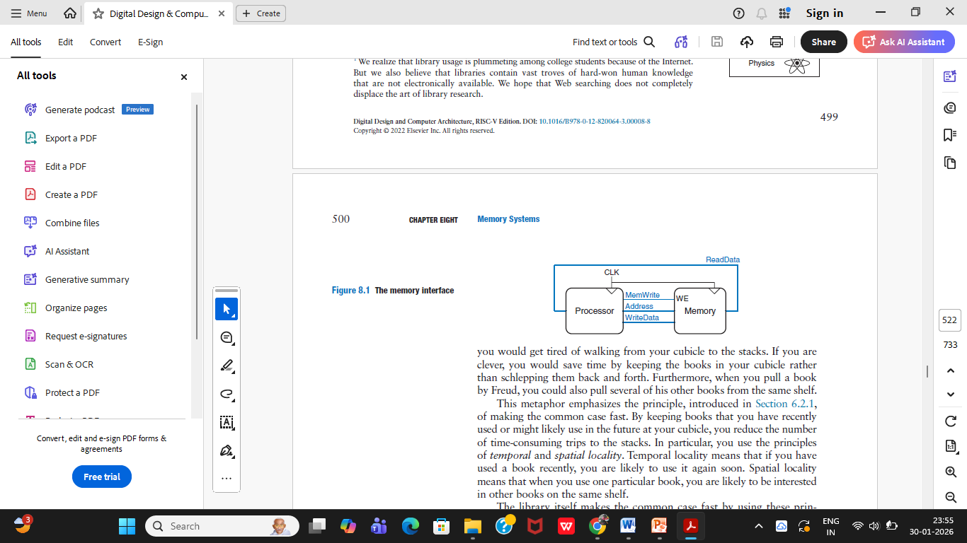

Slide 6
INTRODUCTION
Temporal locality means:
If a memory location is accessed once, it is likely to be accessed again soon.
Spatial locality means:
If a memory location is accessed, nearby memory locations are likely to be accessed soon
Temporal locality means that if you have used a book recently, you are likely to use it again soon.
Spatial locality means that when you use one particular book, you are likely to be interested in other books on the same shelf.

Slide 7
INTRODUCTION
Computers store the most commonly used instructions and data in a faster but smaller memory, called a cache.
If the processor requests data that is available in the cache, it is returned quickly. This is called a cache hit.
Otherwise, the processor retrieves the data from main memory (DRAM). This is called a cache miss.

Slide 8
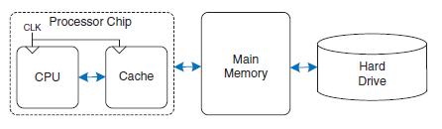
memory hierarchy of the computer system
Figure 8.3

Slide 9
INTRODUCTION
The hard drive provides an illusion of more capacity than actually exists in the main memory.
It is thus called virtual memory.
Like books in the basement, data in virtual memory takes a long time to access.
Main memory, also called physical memory.

Slide 10
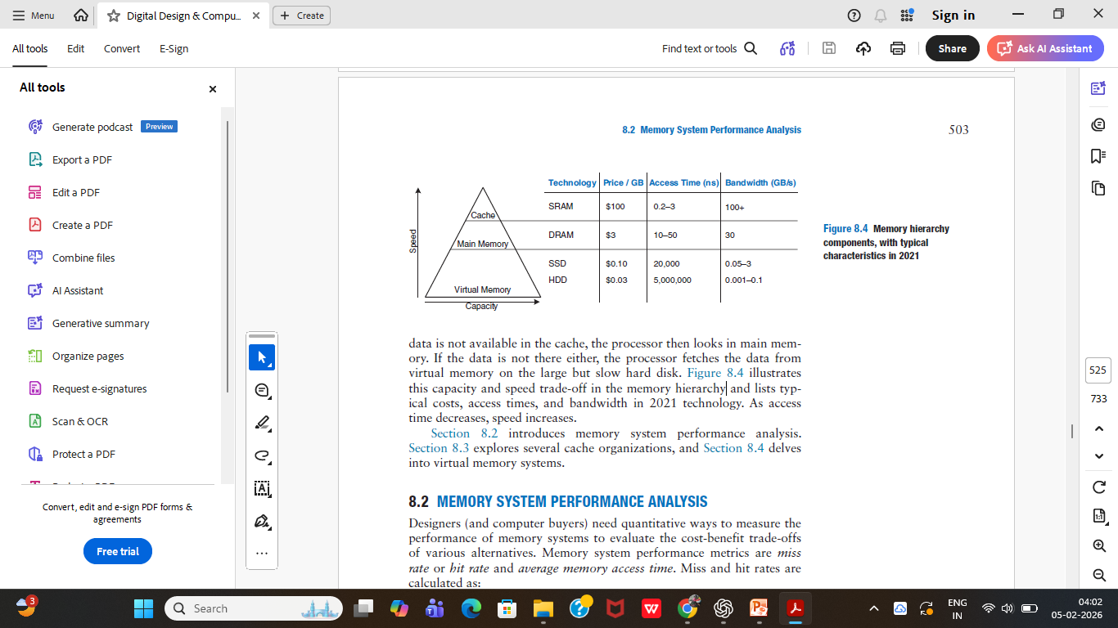
capacity and speed trade-off in the memory hierarchy

Slide 11
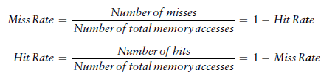
MEMORY SYSTEM PERFORMANCE ANALYSIS
Designers (and computer buyers) need quantitative ways to measure the performance of memory systems to evaluate the cost-benefit trade-offs of various alternatives.
Memory system performance metrics are miss rate or hit rate and average memory access time.
Miss and hit rates are calculated as:

Slide 12
MEMORY SYSTEM PERFORMANCE ANALYSIS
Example 8.1 CALCULATING CACHE PERFORMANCE
Suppose a program has 2,000 data access instructions (loads or stores) and 1,250 of these requested data values are found in the cache. The other 750 data values are supplied to the processor by main memory or disk memory. What are the miss and hit rates for the cache?
Solution:
The miss rate is 750/2000 = 0.375 = 37.5%.
The hit rate is 1250/2000 = 0.625 = 1 − 0.375 = 62.5%

Slide 13
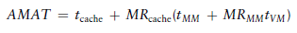
Average memory access time (AMAT) is the average time a processor must wait for memory per load or store instruction.
In the typical computer system from Figure 8.3, the processor first looks for the data in the cache.
If the cache misses, the processor then looks in main memory.
If the main memory misses, the processor accesses virtual memory on the hard disk. Thus, AMAT is calculated as:

Slide 14
where tcache, tMM, and tVM are the access times of the cache, main memory, and virtual memory,
MRcache and MRMM are the cache and main memory miss rates, respectively.

Slide 15
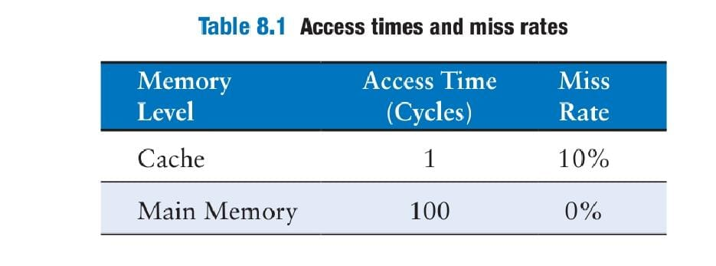
Example 8.2 CALCULATING AVERAGE MEMORY ACCESS TIME
Suppose a computer system has a memory organization with only two levels of hierarchy, a cache and main memory. What is the average memory access time given the access times and miss rates in Table 8.1?
Solution The average memory access time is 1 + 0.1(100) = 11 cycles.

Slide 16
Example 8.3 IMPROVING ACCESS TIME
An 11-cycle average memory access time means that the processor spends ten cycles waiting for data for every one cycle actually using that data. What cache miss rate is needed to reduce the average memory access time to 1.5 cycles given the access times in Table 8.1?

Slide 17
Solution
If the miss rate is m, the average access time is 1 + 100m. Setting this time to 1.5 and solving for m requires a cache miss rate of 0.5%.
Given
From Table 8.1:
Cache access time = 1 cycle
Main memory access time (miss penalty) = 100 cycles
Desired average memory access time (AMAT) = 1.5 cycles
Let the cache miss rate = m.

Slide 18
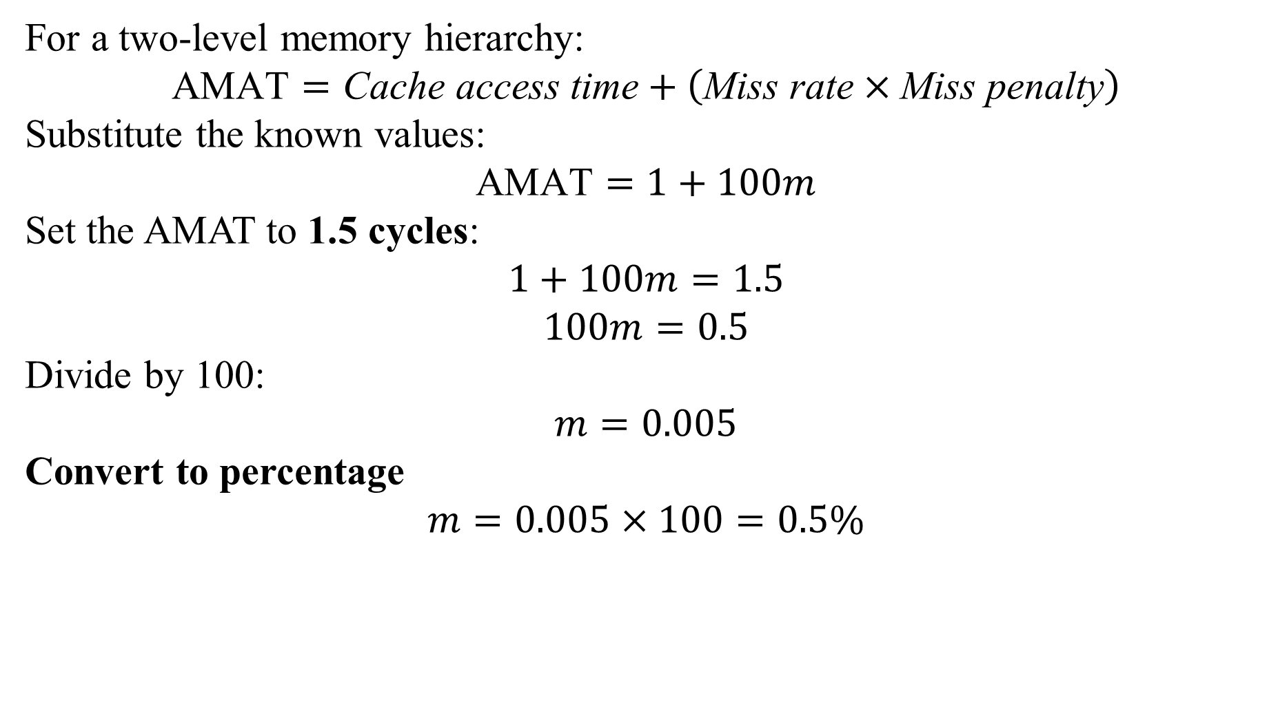
For a two-level memory hierarchy:
$$\text{AMAT}=\text{Cache} \text{access} \text{time}+\left(\text{Miss} \text{rate}×\text{Miss} \text{penalty}\right)$$
Substitute the known values:
$$\text{AMAT}=1+100m$$
Set the AMAT to 1.5 cycles:
$$1+100m=1.5$$
$$100m=0.5$$
Divide by 100:
$$m=0.005$$
Convert to percentage
$$m=0.005×100=0.5\%$$

Slide 19
Caches -
Basic concepts,
Cache mapping,
Cache replacement,
Multiple-Level Caches,
Reducing Miss Rate,
Write Policy;

Slide 20
CACHES: 527
A cache holds commonly used memory data.
The number of data words that it can hold is called the capacity, C.
Because the capacity of the cache is smaller than that of main memory, the computer system designer must choose what subset of the main memory is kept in the cache.
When the processor attempts to access data, it first checks the cache for the data.
If the cache hits, the data is available immediately.
If the cache misses, the processor fetches the data from main memory and places it in the cache for future use.
To accommodate the new data, the cache must replace old data.

Slide 21
CACHES design issues
(1) What data is held in the cache?
(2) How is data found?
(3) What data is replaced to make room for new data when the cache is full?

Slide 22
CACHES terminology
Caches are specified by their capacity (C), number of sets (S), block size (b), number of blocks (B), and degree of associativity (N).
    Capacity (C):
      number of data bytes in cache
    Block size (b):
      bytes of data brought into cache at once
    Number of blocks (B = C/b):
      number of blocks in cache: B = C/b
    Degree of associativity (N):
      number of blocks in a set
    Number of sets (S = B/N):
      each memory address maps to exactly one cache set

Slide 23
What Data is Held in the Cache?
An ideal cache would anticipate all of the data needed by the processor and fetch it from main memory ahead of time so that the cache has a zero miss rate.
Because it is impossible to predict the future with perfect accuracy, the cache must guess what data will be needed based on the past pattern of memory accesses.
In particular, the cache exploits temporal and spatial locality to achieve a low miss rate.

Slide 24
Recall that temporal locality means that the processor is likely to access a piece of data again soon if it has accessed that data recently.
Therefore, when the processor loads or stores data that is not in the cache, the data is copied from main memory into the cache.
Subsequent requests for that data hit in the cache.
Recall that spatial locality means that, when the processor accesses a piece of data, it is also likely to access data in nearby memory locations.
Therefore, when the cache fetches one word from memory, it may also fetch several adjacent words.
This group of words is called a cache block or cache line.

Slide 25
The number of words in the cache block, b, is called the block size.
Capacity (C): number of data bytes in cache
A cache of capacity C contains (no: of blocks) B = C / b blocks.
The principles of temporal and spatial locality have been experimentally verified in real programs.
If a variable is used in a program, the same variable is likely to be used again, creating temporal locality.
If an element in an array is used, other elements in the same array are also likely to be used, creating spatial locality

Slide 26
How is Data Found?
A cache is organized into S sets, each of which holds one or more blocks of data.
The relationship between the address of data in main memory and the location of that data in the cache is called the mapping.
Each memory address maps to exactly one set in the cache.
Some of the address bits are used to determine which cache set contains the data.
If the set contains more than one block, the data may be kept in any of the blocks in the set

Slide 27
How is Data Found?
Caches are categorized based on the number of blocks in a set.
In a direct mapped cache, each set contains exactly one block, so the cache has S = B sets.
Thus, a particular main memory address maps to a unique block in the cache.
In an N-way set associative cache, each set contains N blocks.
The address still maps to a unique set, with S = B/N sets
But the data from that address can go in any of the N blocks in that set.

Slide 28
How is Data Found?
A fully associative cache has only S = 1 set.
Data can go in any of the B blocks in the set.
Hence, a fully associative cache is another name for a B-way set associative cache.

Slide 29
Direct Mapped Cache
A direct mapped cache has one block in each set, so it is organized into S = B sets.
To understand the mapping of memory addresses onto cache blocks, imagine main memory as being mapped into b-word blocks, just as the cache is.
An address in block 0 of main memory maps to set 0 of the cache.
An address in block 1 of main memory maps to set 1 of the cache, and so forth until an address in block B − 1 of main memory maps to block B − 1 of the cache.
There are no more blocks of the cache, so the mapping wraps around, such that block B of main memory maps to block 0 of the cache.
This mapping is illustrated in Figure 8.5 for a direct mapped cache with a capacity of eight words and a block size of one word

Slide 30
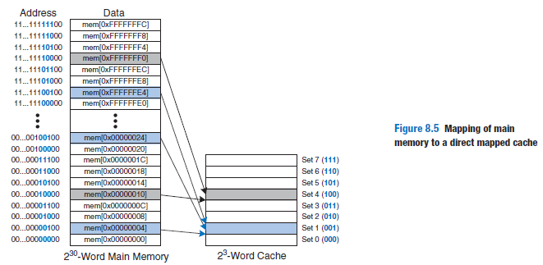
Direct Mapped Cache

Slide 31
Direct Mapped Cache
Example 8.4 CACHE FIELDS
To what cache set in Figure 8.5 does the word at address 0x00000014 map?
Name another address that maps to the same set.
Solution: The two least significant bits of the address are 00, because the address
is word aligned. The next three bits are 101, so the word maps to set 5. Words at
addresses 0x34, 0x54, 0x74, …, 0xFFFFFFF4 all map to this same set.

Slide 32
Because many addresses map to a single set, the cache must also keep track of the address of the data actually contained in each set.
The least significant bits of the address specify which set holds the data.
The remaining most significant bits are called the tag and indicate which of the many possible addresses is held in that set.

Slide 33
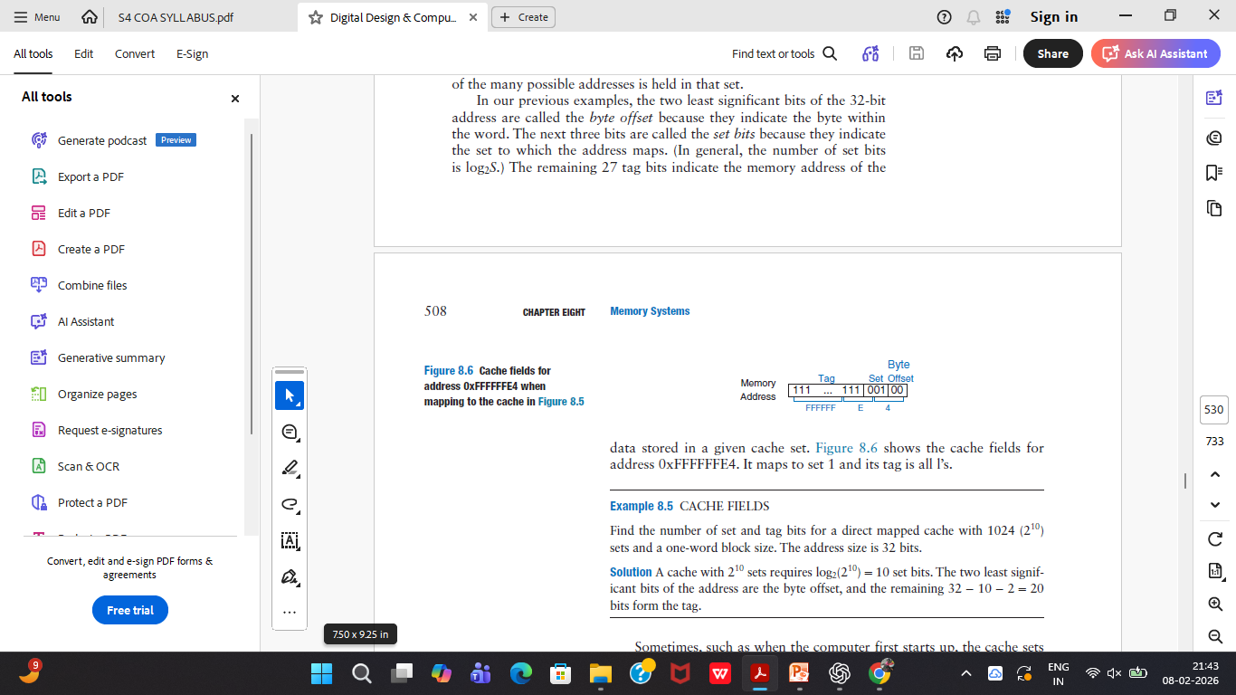

Slide 34
The two least significant bits of the 32-bit address are called the byte offset because they indicate the byte within the word.
The next three bits are called the set bits because they indicate the set to which the address maps.
The remaining 27 tag bits indicate the memory address of the data stored in a given cache set.
Figure 8.6 shows the cache fields for address 0xFFFFFFE4. It maps to set 1 and its tag is all l’s.

Slide 35
Example 8.5 CACHE FIELDS
Find the number of set and tag bits for a direct mapped cache with 1024 (2¹⁰)
sets and a one-word block size. The address size is 32 bits.
Solution
A cache with 2¹⁰ sets requires log₂(2¹⁰) = 10 set bits.
The two least significant bits of the address are the byte offset, and the remaining 32 − 10 − 2 = 20 bits form the tag.

Slide 36
The cache uses a valid bit for each set to indicate whether the set holds meaningful data.
If the valid bit is 0, the contents are meaningless.
Figure 8.7 shows the hardware for the direct mapped cache of Figure 8.5.
The cache is constructed as an eight-entry SRAM.
Each entry, or set, contains one line consisting of 32 bits of data, 27 bits of tag, and 1 valid bit.
The cache is accessed using the 32-bit address.
The two least significant bits, the byte offset bits, are ignored for word accesses.
The next three bits, the set bits, specify the entry or set in the cache.
A load instruction reads the specified entry from the cache and checks the tag and valid bits.

Slide 37
If the tag matches the most significant 27 bits of the requested address and the valid bit is 1, the cache hits and the data is returned to the processor.
Otherwise, the cache misses and the memory system must fetch the data from main memory.

Slide 38
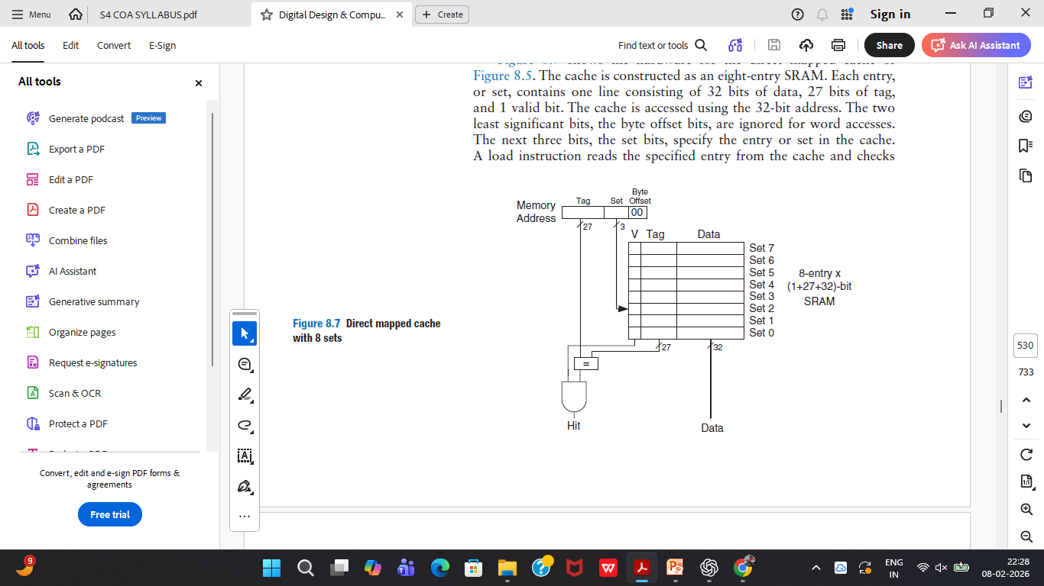

Slide 39
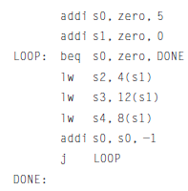
Example 8.6 TEMPORAL LOCALITY WITH A DIRECT MAPPED CACHE
Loops are a common source of temporal and spatial locality in applications. Using the eight-entry cache of Figure 8.7, show the contents of the cache after executing the following silly loop in RISC-V assembly code. Assume that the cache is initially empty. What is the miss rate?

Slide 40
Solution: The program contains a loop that repeats for five iterations.
Each iteration involves three memory accesses (loads), resulting in 15 total memory accesses.
The first time the loop executes, the cache is empty and the data must be fetched from main memory locations 0x4, 0xC, and 0x8 into cache sets 1, 3, and 2, respectively.
However, the next four times the loop executes, the data is found in the cache. Figure 8.8 shows the contents of the cache during the last request to memory address 0x4.
The tags are all 0 because the upper 27 bits of the addresses are 0.
The miss rate is 3/15 = 20%.

Slide 41
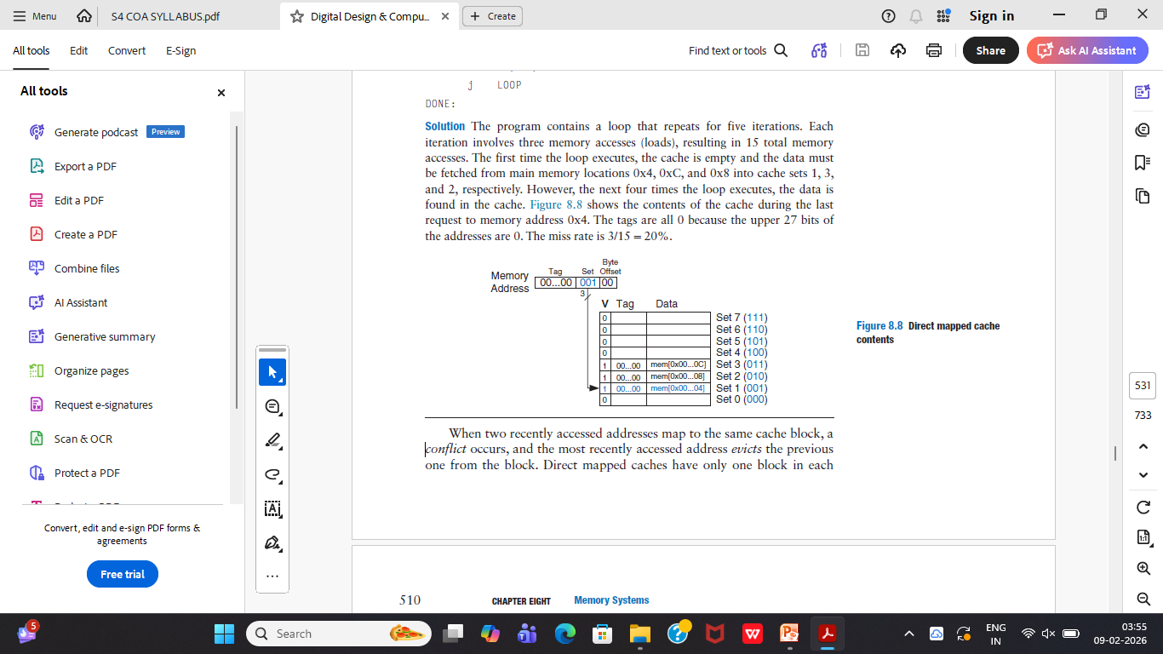

Slide 42
When two recently accessed addresses map to the same cache block, a conflict occurs, and the most recently accessed address evicts the previous one from the block.
Direct mapped caches have only one block in each set, so two addresses that map to the same set always cause a conflict.
Example 8.7 illustrates conflicts.

Slide 43
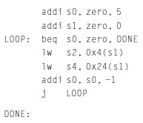
Example 8.7 CACHE BLOCK CONFLICT
What is the miss rate when the following loop is executed on the eight-word direct
mapped cache from Figure 8.7 ? Assume that the cache is initially empty.

Slide 44
Solution: Memory addresses 0x4 and 0x24 both map to set 1.
During the initial execution of the loop, data at address 0x4 is loaded into set 1 of the cache.
Then, data at address 0x24 is loaded into set 1, evicting the data from address
0x4.
Upon the second execution of the loop, the pattern repeats and the cache
must refetch data at address 0x4, evicting data from address 0x24.
The two addresses conflict and the miss rate is 100%.

Slide 45
Multiway Set Associative Cache: 532
An N-way set associative cache reduces conflicts by providing N blocks in each set where data mapping to that set might be found.
Each memory address still maps to a specific set, but it can map to any one of the N blocks in the set.
Hence, a direct mapped cache is another name for a one-way set associative cache.
N is also called the degree of associativity of the cache.

Slide 46
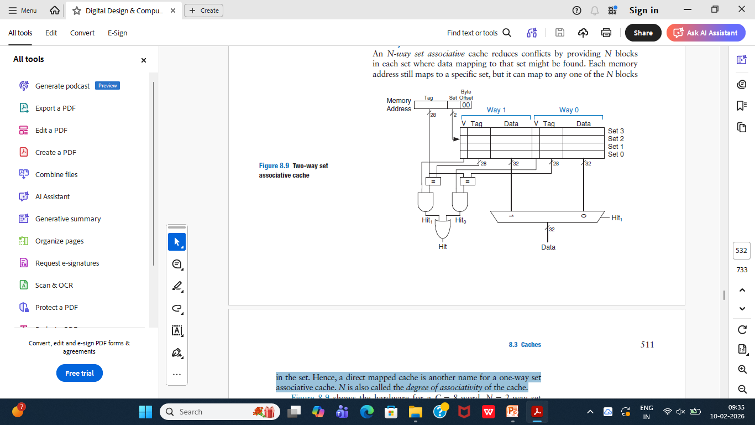

Slide 47
Figure 8.9 shows the hardware for a C = 8-word, N = 2-way set associative cache.
The cache now has only S = 4 sets rather than 8.
Thus, only log24 = 2 set bits rather than 3 are used to select the set.
The tag increases from 27 to 28 bits.
Each set contains two ways or degrees of associativity.
Each way consists of a data block and the valid and tag bits.
The cache reads blocks from both ways in the selected set and checks the tags and valid bits for a hit.
If a hit occurs in one of the ways, a multiplexer selects data from that way.

Slide 48
Set associative caches generally have lower miss rates than direct mapped caches of the same capacity because they have fewer conflicts.
However, set associative caches are usually slower and somewhat more expensive to build because of the output multiplexer and additional comparators.
They also raise the question of which way to replace when both ways are full

Slide 49
Fully Associative Cache: 533
A fully associative cache contains a single set with B ways, where B is the number of blocks.
A memory address can map to a block in any of these ways.
A fully associative cache is another name for a B-way set associative cache with one set.
Figure 8.11 shows a fully associative cache with eight blocks.
Upon a data request, eight tag comparisons (not shown) must be made because the data could be in any block. Similarly, an 8:1

Slide 50
Similarly, an 8:1multiplexer chooses the proper data if a hit occurs.
Fully associative caches tend to have the fewest conflict misses for a given cache capacity, but they require more hardware for additional tag comparisons.
They are best suited to relatively small caches because of the large number of comparators.

Slide 51
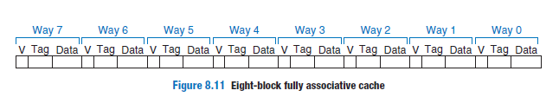
The time required to load the missing block into the cache is called the miss penalty.

Slide 52
CACHE REPLACEMENT
In a direct mapped cache, each address maps to a unique block and set.
If a set is full when new data must be loaded, the block in that set is replaced with the new data.
In set associative and fully associative caches, the cache must choose which block to evict when a cache set is full.
The principle of temporal locality suggests that the best choice is to evict the least recently used block .
Hence, most associative caches have a least recently used (LRU) replacement policy.

Slide 53
In a two-way set associative cache, a use bit, U, indicates which way within a set was least recently used.
Each time one of the ways is used, U is adjusted to indicate the other way.
For set associative caches with more than two ways, tracking the least recently used way becomes complicated.
To simplify the problem, the ways are often divided into two groups and U indicates which group of ways was least recently used.
Upon replacement, the new block replaces a random block within the least recently used group.
Such a policy is called pseudo-LRU and is good enough in practice.

Slide 54
Example 8.10 LRU REPLACEMENT
Show the contents of an eight-word two-way set associative cache after executing
the following code. Assume LRU replacement, a block size of one word, and an
initially empty cache.
        addi t0, zero, 0
        lw s1, 0x4(t0)
        lw s2, 0x24(t0)
        lw s3, 0x54(t0)

Slide 55
Solution:
The first two instructions load data from memory addresses 0x4 and
0x24 into set 1 of the cache, shown in Figure 8.15(a).
U = 0 indicates that data in way 0 was the least recently used.
The next memory access, to address 0x54, also maps to set 1 and replaces the least recently used data in way 0, as shown in Figure 8.15(b).
The use bit U is set to 1 to indicate that data in way 1 was the least recently used.

Slide 56
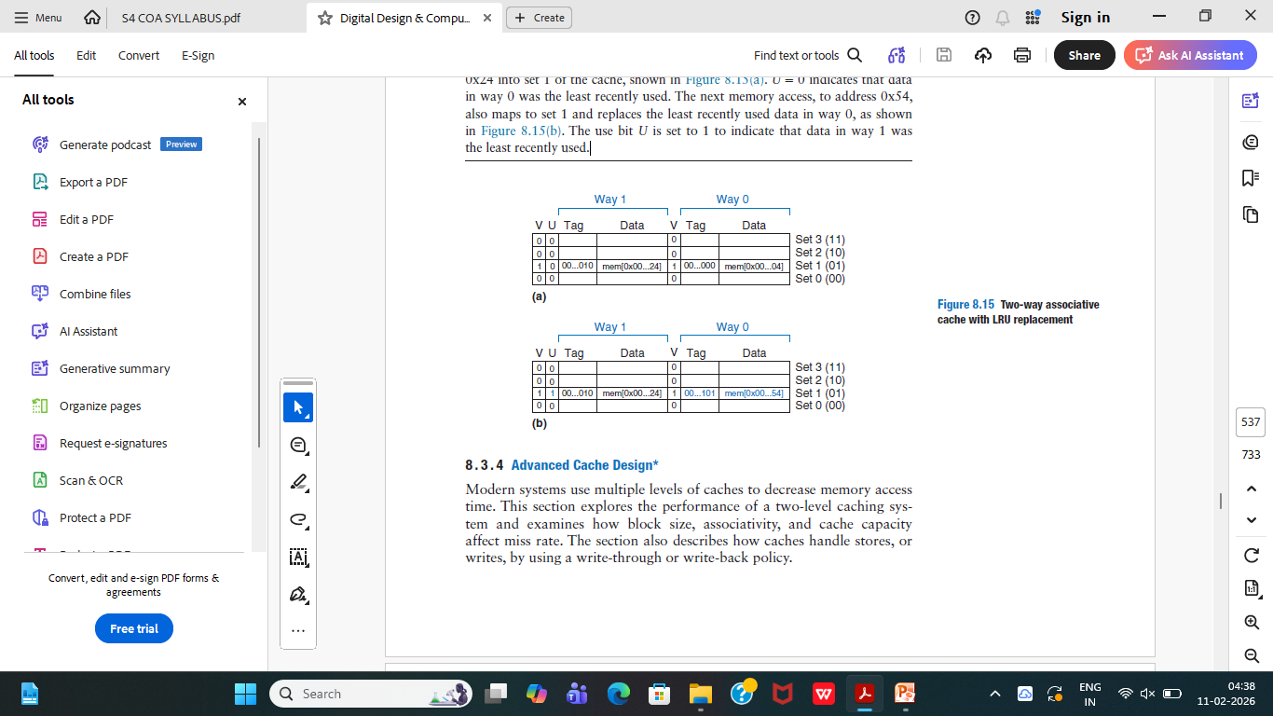

Slide 57
Multiple-Level Caches: 538
Modern systems use multiple levels of caches to decrease memory access time.
Large caches are beneficial because they are more likely to hold data of interest and, therefore, have lower miss rates.
However, large caches tend to be slower than small ones.
Modern systems often use at least two levels of caches, as shown in Figure 8.16.
The first-level (L1) cache is small enough to provide a one- or two-cycle access time.

Slide 58
The second-level (L2) cache is also built from SRAM but is larger—and, therefore, slower—than the L1 cache.
The processor first looks for the data in the L1 cache.
If the L1 cache misses, the processor looks in the L2 cache.
If the L2 cache misses, the processor fetches the data from main memory.
Many modern systems add even more levels of cache to the memory hierarchy because accessing main memory is so slow.

Slide 59
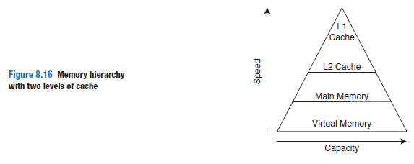

Slide 60
Example 8.11 SYSTEM WITH AN L2 CACHE
Use the system of Figure 8.16 with access times of 1, 10, and 100 cycles for the
L1 cache, L2 cache, and main memory, respectively. Assume that the L1 and L2
caches have miss rates of 5% and 20%, respectively. Specifically, of the 5% of
accesses that miss the L1 cache, 20% of those also miss the L2 cache. What is
the average memory access time (AMAT)?

Slide 61
Solution:
Each memory access checks the L1 cache.
When the L1 cache misses (5% of the time), the processor checks the L2 cache.
When the L2 cache misses (20% of the time), the processor fetches the data from main memory.
Using Equation 8.2, we calculate the average memory access time as follows:
1 cycle + 0.05[10 cycles + 0.2(100 cycles)] = 2.5 cycles.
The L2 miss rate is high because it receives only the “hard” memory accesses, those
that miss in the L1 cache.
If all accesses went directly to the L2 cache, the L2 miss
rate would be about 1%.

Slide 62
Reducing Miss Rate: 539
Cache misses can be reduced by changing
        capacity,
        block size, and/or
        associativity.
The first step to reducing the miss rate is to understand the causes of the misses.
The misses can be classified as compulsory, capacity, and conflict.
The first request to a cache block is called a compulsory miss, because the block must be read from memory regardless of the cache design.
Capacity misses occur when the cache is too small to hold all concurrently used data.
Conflict misses are caused when several addresses map to the same set and evict blocks that are still needed.

Slide 63
Increasing cache capacity can reduce conflict and capacity misses.
Increasing block size could reduce compulsory misses (due to spatial locality)
when cache size increases, capacity misses decrease.
Increased associativity, especially for small caches, decreases the number of conflict misses.
Increasing associativity beyond four or eight ways provides only small decreases in miss rate.

Slide 64
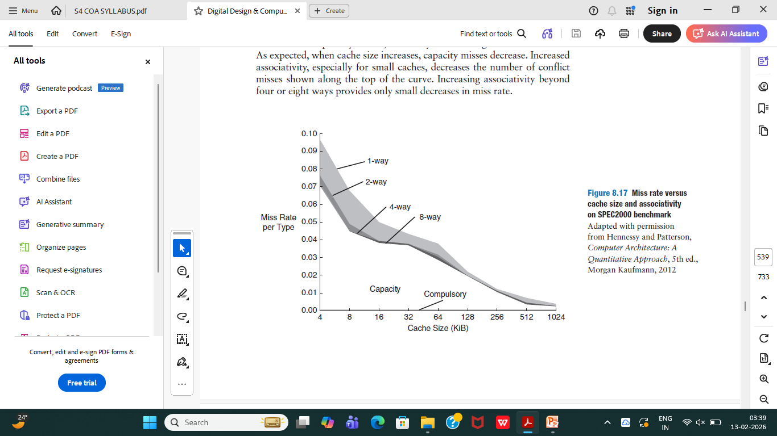

Slide 65
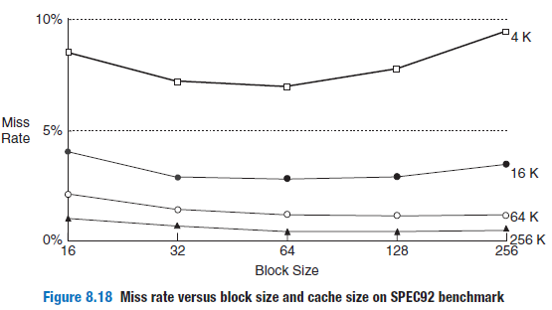
Miss rate can also be decreased by using larger block sizes that take advantage of spatial locality.
But as block size increases, the number of sets in a fixed-size cache decreases, increasing the probability of conflicts.

Slide 66
WRITE POLICY: 540
Upon a memory store, the processor checks the cache.
If the cache misses, the cache block is fetched from main memory into the cache, and then the appropriate word in the cache block is written.
If the cache hits, the word is simply written to the cache block.
Caches are classified as either write-through or write-back.
In a write-through cache, the data written to a cache block is simultaneously written to main memory.

Slide 67
In a write-back cache, a dirty bit (D) is associated with each cache block.
D is 1 when the cache block has been written and 0 otherwise.
Dirty cache blocks are written back to main memory only when they are evicted from the cache.
A write-through cache requires no dirty bit but usually requires more main memory writes than a write-back cache.
Modern caches are usually write-back because main memory access time is so large.

Slide 68
Example 8.12 WRITE-THROUGH VERSUS WRITE-BACK
Suppose a cache has a block size of four words. How many main memory accesses are required by the following code when using each write policy: write-through or write-back?
      addi t5, zero, 0
      sw t1, 0(t5)
      sw t2, 12(t5)
      sw t3, 8(t5)
      sw t4, 4(t5)

Slide 69
Solution:
All four store instructions write to the same cache block. With a write-through
cache, each store instruction writes a word to main memory, requiring four main memory writes. A write-back policy requires only one main memory access, when the dirty cache block is evicted.

Slide 70
Virtual Memory -
Address Translation;
Page Table;
Translation Lookaside Buffer;
Memory Protection.

Slide 71
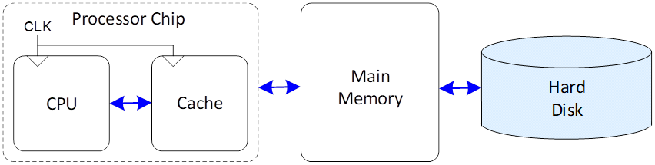
VIRTUAL MEMORY: 541
Give the illution of bigger memory.
Most modern computer systems use a hard drive made of magnetic or solid-state storage as the lowest level in the memory hierarchy.
Compared with the ideal large, fast, cheap memory, a hard drive is large and cheap but terribly slow.
It provides a much larger capacity than is possible with a cost-effective main memory (DRAM).

Slide 72
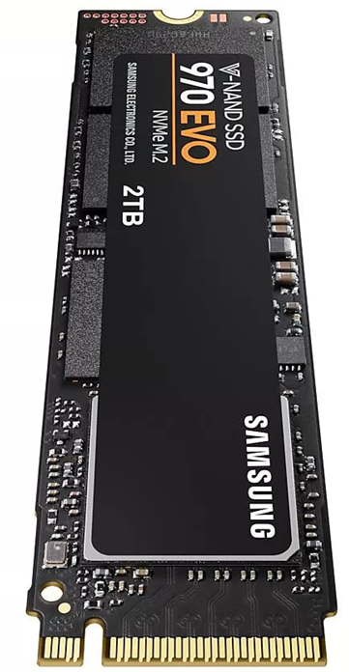
Figure 8.19 shows a hard drive made of magnetic storage, also called a hard disk
Solid State Drive

Slide 73
The hard disk contains one or more rigid disks or platters, each of which has a read/write head on the end of a long triangular arm.
The head moves to the correct location on the disk and reads or writes data magnetically as the disk rotates beneath it.
The head takes several milliseconds to seek the correct location on the disk, which is fast from a human perspective but millions of times slower than the processor.
Hard disk drives are increasingly being replaced by solid-state drives because reading is faster and they are not as subject to mechanical failures.

Slide 74
A computer with only 16 GiB of DRAM, for example, could effectively provide 128 GiB of memory using the hard drive.
This larger 128 GiB memory is called virtual memory, and the smaller 16 GiB main memory is called physical memory.
Programs can access data anywhere in virtual memory, so they must use virtual addresses that specify the location in virtual memory.
The physical memory holds a subset of most recently accessed virtual memory.
In this way, physical memory acts as a cache for virtual memory.

Slide 75
Virtual memory is divided into virtual pages, typically 4 KiB in size.
Physical memory is likewise divided into physical pages of the same size.
A virtual page may be located in physical memory (DRAM) or on the hard drive.
For example, Figure 8.20 shows a virtual memory that is larger than physical memory.
The rectangles indicate pages.

Slide 76
Some virtual pages are present in physical memory, and some are located on the hard drive.
The process of determining the physical address from the virtual address is called address translation.
If the processor attempts to access a virtual address that is not in physical memory, a page fault occurs and the operating system (OS) loads the page from the hard drive into physical memory.

Slide 77
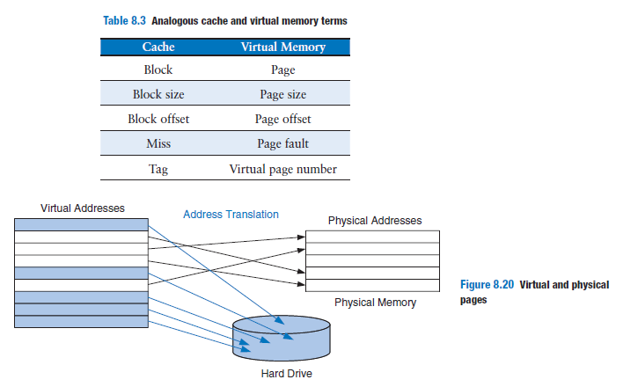

Slide 78
To avoid page faults caused by conflicts, any virtual page can map to any physical page.
In other words, physical memory behaves as a fully associative cache for virtual memory.
In a conventional fully associative cache, every cache block has a comparator that checks the most significant address bits against a tag to determine whether the request hits in the block.
In an analogous virtual memory system, each physical page would need a comparator to check the most significant virtual address bits against a tag to determine whether the virtual page maps to that physical page.

Slide 79
A realistic virtual memory system has so many physical pages that providing a comparator for each page would be excessively expensive.
Instead, the virtual memory system uses a page table to perform address translation.
A page table contains an entry for each virtual page, indicating its location in physical memory or that it is on the hard drive.
Each load or store instruction requires a page table access followed by a physical memory access.
The page table access translates the virtual address used by the program to a physical address.
The physical address is then used to actually read or write the data.

Slide 80
The page table is usually so large that it is located in physical memory.
Hence, each load or store involves two physical memory accesses: a page table access and a data access.
To speed up address translation, a translation lookaside buffer (TLB) caches the most commonly used page table entries.

Slide 81
Address Translation: 544
In a system with virtual memory, programs use virtual addresses so that they can access a large memory.
The computer must translate these virtual addresses to either find the address in physical memory or take a page fault and fetch the data from the hard drive.
Virtual memory and physical memory are divided into pages.
The most significant bits of the virtual or physical address specify the virtual or physical page number.
The least significant bits specify the word within the page and are called the page offset.

Slide 82
Figure 8.21 illustrates the page organization of a virtual memory system with 2 GiB of virtual memory and 128 MiB of physical memory divided into 4 KiB pages.
MIPS accommodates 32-bit addresses.
With a 2 GiB = 2³¹-byte virtual memory, only the least significant 31 virtual address bits are used; the 32 nd bit is always 0.
Similarly, with a 128 MiB = 2²⁷-byte physical memory, only the least significant 27 physical address bits are used; the upper 5 bits are always 0.

Slide 83
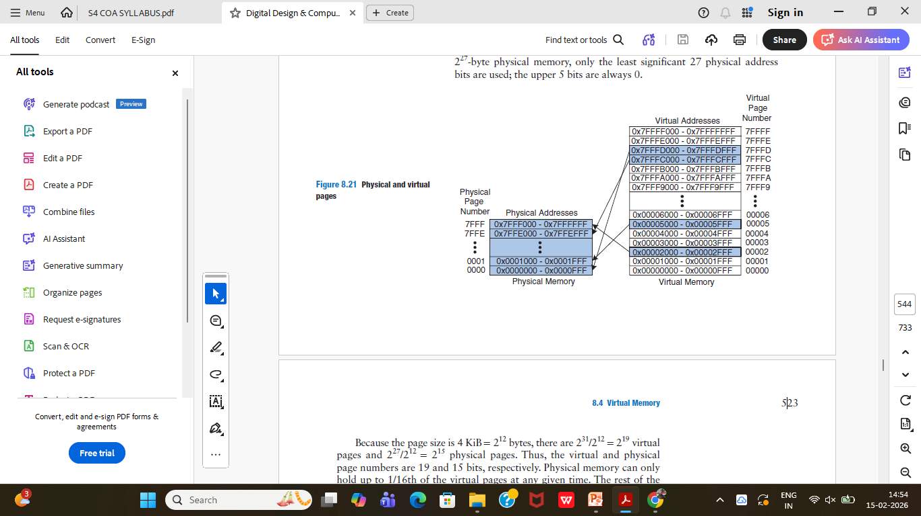

Slide 84
Because the page size is 4 KiB = 2¹² bytes, there are 2³¹/2¹² = 2¹⁹ virtual pages and 2²⁷/2¹² = 2¹⁵ physical pages.
Thus, the virtual and physical page numbers are 19 and 15 bits, respectively.
The rest of the virtual pages are kept on the hard drive.

Slide 85
Figure 8.21 shows virtual page 5 mapping to physical page 1, virtual page 0x7FFFC mapping to physical page 0x7FFE, and so forth.
For example, virtual address 0x53F8 (an offset of 0x3F8 within virtual page 5) maps to physical address 0x13F8 (an offset of 0x3F8 within physical page 1).
The least significant 12 bits of the virtual and physical addresses are the same (0x3F8) and specify the page offset within the virtual and physical pages.
Only the page number needs to be translated to obtain the physical address from the virtual address.

Slide 86
Figure 8.22 illustrates the translation of a virtual address to a physical address.
The least significant 12 bits indicate the page offset and require no translation.
The upper 19 bits of the virtual address specify the virtual page number (VPN) and are translated to a 15-bit physical page number (PPN).
The next two sections describe how page tables and TLBs are used to perform this address translation.

Slide 87
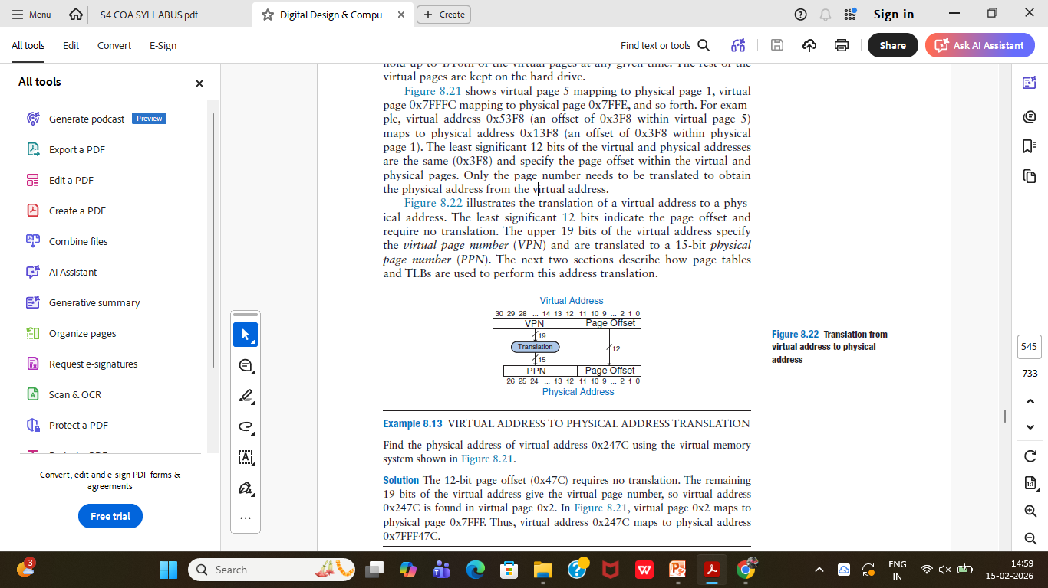

Slide 88
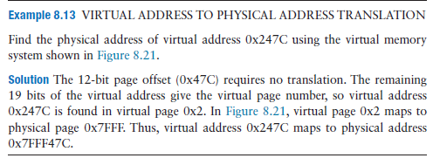

Slide 89
The Page Table: 545
The processor uses a page table to translate virtual addresses to physical addresses.
The page table contains an entry for each virtual page.
This entry contains a physical page number and a valid bit.
If the valid bit is 1, the virtual page maps to the physical page specified in the entry.
Otherwise, the virtual page is found on the hard drive.
Because the page table is so large, it is stored in physical memory.

Slide 90
The Page Table: 545
Let us assume that it is stored as a contiguous array, as shown in Figure 8.23.
This page table contains the mapping of the memory system of Figure 8.21.
The page table is indexed with the virtual page number (VPN).
For example, entry 5 specifies that virtual page 5 maps to physical page 1.
Entry 6 is invalid (V = 0), so virtual page 6 is located on the hard drive.

Slide 91
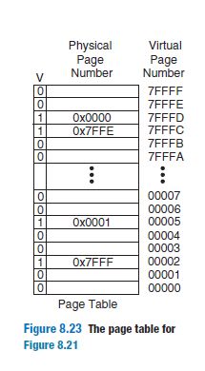

Slide 92
The Page Table: 545
The page table can be stored anywhere in physical memory at the discretion of the OS.
The processor typically uses a dedicated register, called the page table register, to store the base address of the page table in physical memory.
To perform a load or store, the processor must first translate the virtual address to a physical address and then access the data at that physical address.
The processor extracts the virtual page number from the virtual address and adds it to the page table register to find the physical address of the page table entry.

Slide 93
The Page Table: 545
The processor then reads this page table entry from physical memory to obtain the physical page number.
If the entry is valid, it merges this physical page number with the page offset to create the physical address.
Finally, it reads or writes data at this physical address.
Because the page table is stored in physical memory, each load or store involves two physical memory accesses.

Slide 94
Example 8.14
USING THE PAGE TABLE TO PERFORM ADDRESS TRANSLATION
Find the physical address of virtual address 0x247C using the page table shown
in Figure 8.23.

Slide 95
Solution:
Figure 8.24 shows the virtual address to physical address translation for
virtual address 0x247C.
The 12-bit page offset requires no translation.
The remaining 19 bits of the virtual address are the virtual page number, 0x2, and give the index into the page table.
The page table maps virtual page 0x2 to physical page 0x7FFF.
So, virtual address 0x247C maps to physical address 0x7FFF47C.
The least significant 12 bits are the same in both the physical and the virtual address.

Slide 96
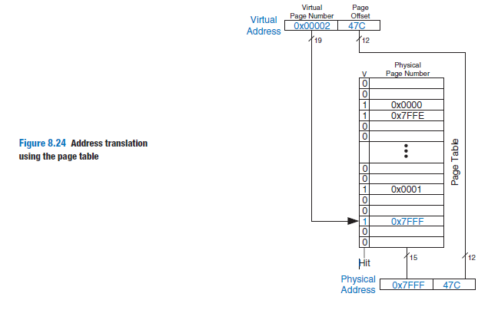

Slide 97
The Page Table: 545
The processor then reads this page table entry from physical memory to obtain the physical page number.
If the entry is valid, it merges this physical page number with the page offset to create the physical address.
Finally, it reads or writes data at this physical address.
Because the page table is stored in physical memory, each load or store involves two physical memory accesses.

Slide 98
The Translation Lookaside Buffer: 547
Virtual memory would have a severe performance impact if it required a page table read on every load or store, doubling the delay of loads and stores.
Page table accesses have great temporal locality.
The temporal and spatial locality of data accesses and the large page size mean that many consecutive loads or stores are likely to reference the same page.
Therefore, if the processor remembers the last page table entry that it read, it can probably reuse this translation without rereading the page table.
The processor can keep the last several page table entries in a small cache called a translation lookaside buffer (TLB).

Slide 99
The processor “looks aside” to find the translation in the TLB before having to access the page table in physical memory.
In real programs, the vast majority of accesses hit in the TLB, avoiding the time-consuming page table reads from physical memory.
A TLB is organized as a fully associative cache and typically holds 16 to 512 entries.
Each TLB entry holds a virtual page number and its corresponding physical page number.
The TLB is accessed using the virtual page number.

Slide 100
If the TLB hits, it returns the corresponding physical page number.
Otherwise, the processor must read the page table in physical memory.
The TLB is designed to be small enough that it can be accessed in less than one cycle.
Even so, TLBs typically have a hit rate of greater than 99%.

Slide 101
Example 8.15 USING THE TLB TO PERFORM ADDRESS TRANSLATION
Consider the virtual memory system of Figure 8.21. Use a two-entry TLB or
explain why a page table access is necessary to translate virtual addresses
0x247C and 0x5FB0 to physical addresses. Suppose that the TLB currently
holds valid translations of virtual pages 0x2 and 0x7FFFD.

Slide 102
Solution:
Figure 8.25 shows the two-entry TLB with the request for virtual address 0x247C. The TLB receives the virtual page number of the incoming address, 0x2, and compares it to the virtual page number of each entry.
Entry 0 matches and is valid, so the request hits.
The translated physical address is the physical page number of the matching entry, 0x7FFF, concatenated with the page offset of the virtual address.
As always, the page offset requires no translation.
The request for virtual address 0x5FB0 misses in the TLB.
So, the request is forwarded to the page table for translation.

Slide 103
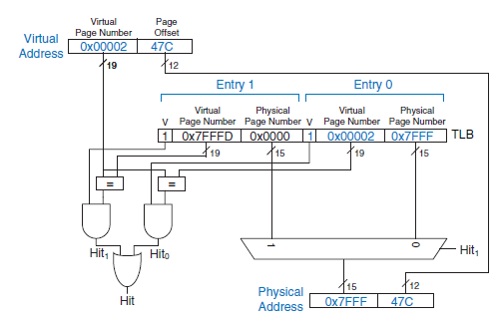
Figure 8.25 Address translation using a two-entry TLB

Slide 104
Memory Protection: 548
An important reason to use virtual memory is to provide protection between concurrently running programs.
Modern computers typically run several programs or processes at the same time.
All of the programs are simultaneously present in physical memory.
No program should be able to access another program’s memory without permission.
This is called memory protection.
Virtual memory systems provide memory protection by giving each program its own virtual address space.
Each program can use as much memory as it wants in that virtual address space, but only a portion of the virtual address space is in physical memory at any given time.
A program can access only those physical pages that are mapped in its page table.

Slide 105
END

